Slide 1

HR Analytics Dashboard:
By: Harish Sreenivasan

Slide 2
The company wants to access the cause of employee turnover ratio by making analysis of the past 15 years records The tool used for the analysis : Microsoft Power BI The high concerning factors were: pay grade, department, travel time during work, gender, age group.
Objective

Slide 3
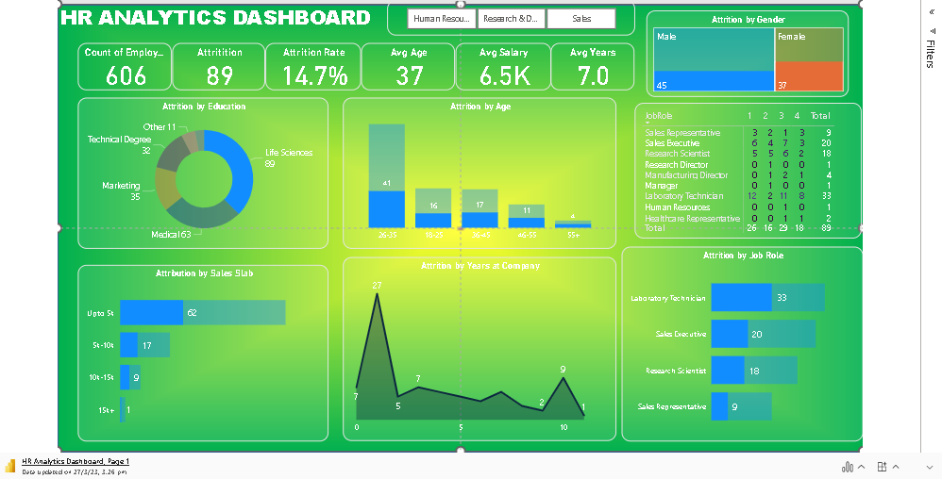

Slide 4
Observations
Mostly employee with lower pay grade i.e 5k are the one ones leaving the highest
Average retention is 7 years which is good sigh
Highest attrition is in employees with education background with life science
Max attrition age group is between 26-35
Laboratory Technicon are the job role holder with max attrition
The male attrition is higher compared to female

Slide 5
Recommendation
Minimum pay amount should be increased
More engagement activities should introduced to develop bonding
The male employees within the age group of 26-35
should be given timely promotion and pay hike to motivate them to stay longer
Employees with Life science education background should be provided with more opportunities so they develop more interest towards retention for the company.

Slide 6
Thank You

